Slide 1
Heuristic Algorithms: Travelling Salesman Problem
By: Ryan Goh

Slide 2
What I know

Slide 3
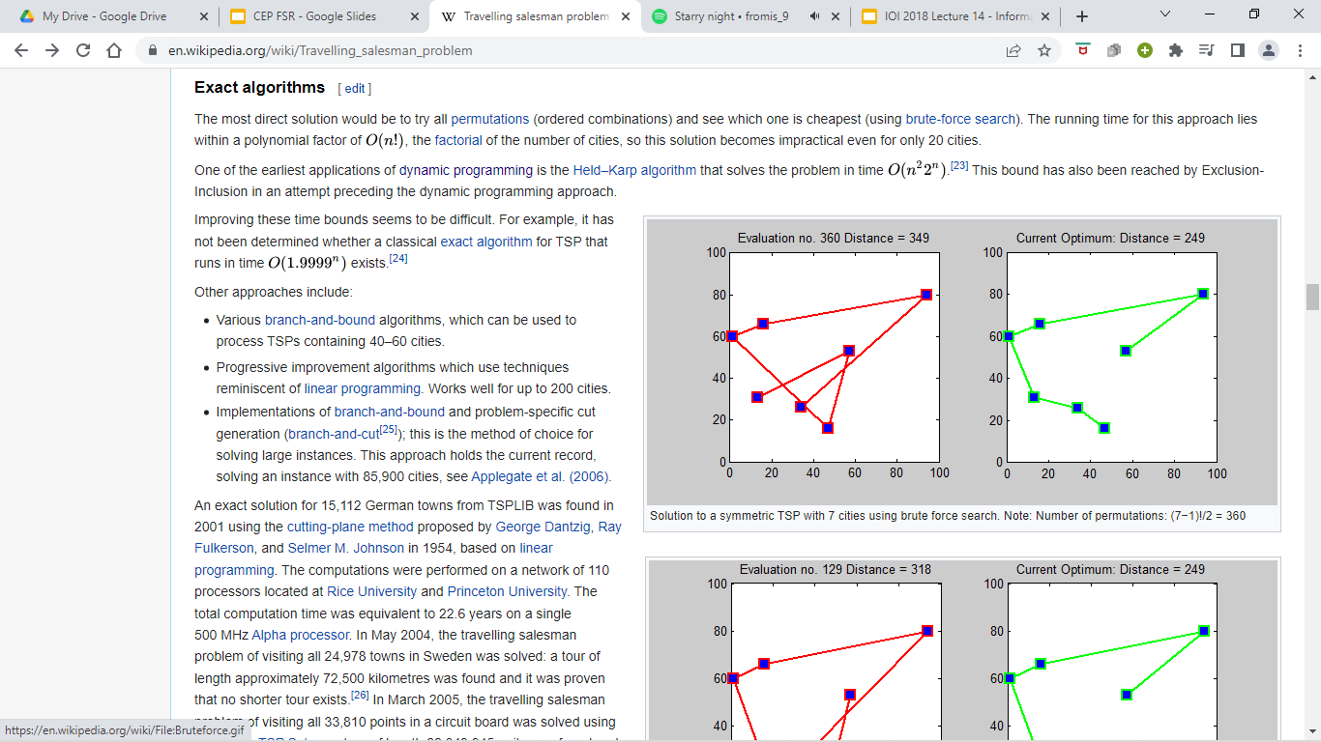
Travelling Salesman Problem (TSP for short)
There are N nodes on a 2D space, labelled from 0 to N-1. We have to find the shortest cycle that each node exactly once and return to the starting point.
For example,
Source: Wikipedia (edited)

Slide 4
Exact Algorithms
Brute Force
Test all N! possible routes, choose the one with the smallest length.
Time complexity: O(N*N!)

Slide 5
Exact Algorithms
2. Dynamic Programming (Held-Karp algorithm)
Let DP(current node, set of visited nodes) = min cost to visit all the unvisited nodes while respecting the constraints, and return to 0.
We start with DP(0, ∅).
For all X, DP(X, {0,1,2,...,N-1}) = dist(X, 0).
Then DP(current node, set of visited nodes) = minimum DP(X, set of visited nodes + X) + dist(current node, X), for all X not in the set of visited nodes.
Find answer from DP(0, ∅).
Time complexity: O(N^2*2^N)

Slide 6
Background Knowledge
TSP is known to be NP-hard, ie. it is not known whether a solution with polynomial time complexity exist.
So let’s go into heuristics algorithms, where we trade time for correctness.

Slide 7
What I wonder

Slide 8
Heuristic Algorithms
“A heuristic algorithm is one that is designed to solve a problem in a faster and more efficient fashion than traditional methods by sacrificing optimality, accuracy, precision, or completeness for speed.”
Here is what I would like to explore:
What are some (easy to implement) heuristic algorithms out there that can solve TSP?
How close are these solutions to the best solution?

Slide 9
Find and Share

Slide 10
Greedy Algorithms
Nearest Neighbour
Use a node as a starting point.
Go to the next unvisited node that is the closest to you.
Repeat step b until there are no nodes left.
(If required) Repeat step a. for all nodes. Find the path with the minimum distance.
Time Complexity: O(N^2) / O(N^3) if all starting nodes are tried.
Correctness: 25% worse than best path on average.
(stats from research paper about TSP)

Slide 11
Greedy Algorithms
Shortest Edge
Sort all the distances between every 2 nodes.
From the smallest distance, join the corresponding 2 nodes together. However, one can only join if the resulting graph after the join is i) a line, or ii) a cycle with N nodes.
i) can be checked in O(1) by ensuring that no node joins more than 2 nodes together.
ii) can be checked in very close to O(1) by a data structure called Disjoint Set Union.
Stop when the graph is a cycle with N nodes. That is the solution.
Time Complexity: O(N^2log(N)) Correctness: 20% worse than best path on average
Forms a cycle with < 6 nodes
Legend:
Original Edge
Valid Join
Graph is not a line
Invalid Join

Slide 12
k-opt Algorithm
Sounds complicated, but it is just… take any k edges from a path that satisfies all the constraints (a cycle of N nodes) and remove them.
Now, join the paths together in a different way such that it forms a cycle of N nodes again.
Eg, an operation
of 2-opt:

Slide 13
k-opt Algorithm
Only perform the operation if it minimises total cost!
Can be checked in O(k)
If no more operations can minimise total cost, we return current path.
Correctness: 5% worse for 2-opt; 3% for 3-opt; diminishing returns as k increases.

Slide 14
k-opt Algorithm
Time complexity (for 2-opt):
Let c be the number of successful operations. Assuming that each operation is O(N) (O(logN) is possible but implementation is cancer)
O(cN + N^2): for each edge (x, y) in the original path, find another edge (u, v) in the original path, test whether you should do the operation on these 2 edges.
O(cN + MN) exists, where M is some arbitrary constant, but may be a little less optimal.

Slide 15
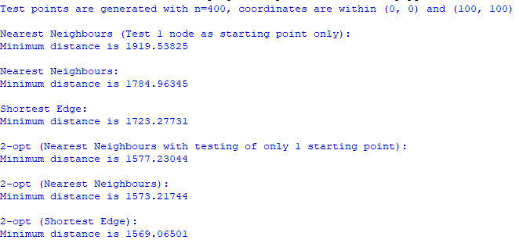
Conclusion
Sometimes, we need to trade time for accuracy.
Hence, the algorithms we choose to solve problems may be very dependent on context.

Slide 16
Demonstration

Slide 17
End
Any Questions?

Slide 18
References
https://optimization.mccormick.northwestern.edu/index.php/Heuristic_algorithms
http://160592857366.free.fr/joe/ebooks/ShareData/Heuristics%20for%20the%20Traveling%20Salesman%20Problem%20By%20Christian%20Nillson.pdf

